Slide 1

Steiner Tree and
Traveling Salesman Problem
Master in Digital Technology
Student ID: 603927
TU Clausthal

Slide 2

Motivation
Why Study These Problems?
  Many real-world problems require connecting locations at minimum cost
    Examples:
      Network design (fiber, internet, roads)
      VLSI chip wiring
      Biological phylogenetic trees
      Logistics and route planning
  Two fundamental questions arise:
    How to connect points cheaply? (Steiner Tree)
    How to visit all points efficiently? (TSP)
  Exact solutions are computationally infeasible
  We therefore study approximation algorithms

Slide 3
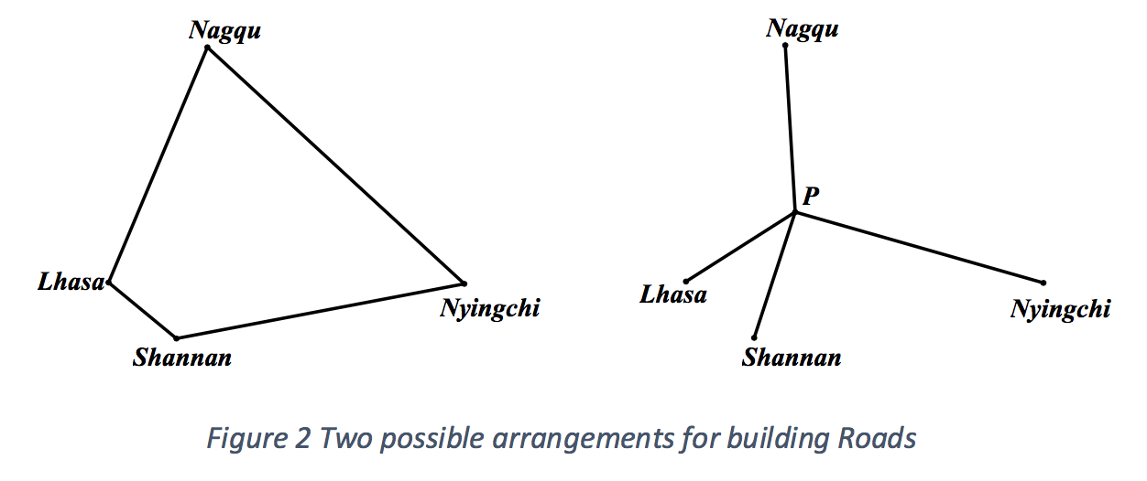
City Connections Example
Cities connecting directly
Cities connected with junction

Slide 4

The Steiner Tree Problem
Connecting terminals with minimum cost

Slide 5
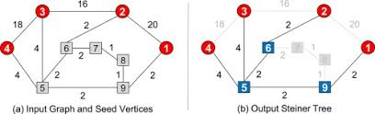
Block 1: Problem 3.1(Steiner Tree)
Concept
Given:
  An undirected graph
    G = ( V , E )
  Each edge has a non-negative cost
  Vertices are split into two groups:
    Required vertices (terminals)
    Steiner vertices (optional)
Objective:
  Find a minimum-cost tree that:
    Contains all required vertices
    May contain any subset of Steiner vertices
Diagram: Showing : input graph and Steiner Tree

Slide 6

Block 1: Metric Steiner Tree
Concept
Given:
  We focus on the Metric Case.
  Costs are non-negative.
  The graph is complete.
  Crucial Rule: Triangle Inequality holds.
Simple Triangle u,v,w show direct path u to v is shorter than going u - w to v.

Slide 7
Block 1: Theorem 3.2: The Reduction
  There is an approximation-factor preserving reduction from Steiner Tree to Metric Steiner Tree.
  Approximation-Factor Preserving: The "closeness" to the perfect answer remains the same in both versions.
  If we solve the "Metric" version, we have effectively solved the "General" version without losing any quality in our answer.
Visual: An arrow showing: [General Problem] \to [Reduction] \to [Metric Problem]

Slide 8
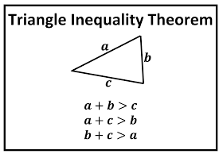
Block 1: Traingle Inequality
  The core of the problem lies in how edge costs behave
  We focus on instances where:
    The graph is complete
    Edge costs are non-negative
    Triangle inequality holds:
      cost(u,v) ≤ cost(u,w) + cost(w,v)
  Triangle inequality ensures distances behave realistically
  In a metric world, the shortest distance between two points is a direct line.
Trainagle Inequality Theorem

Slide 9
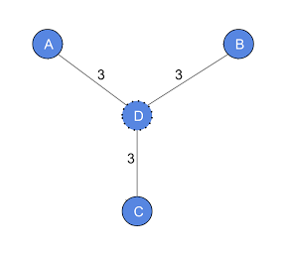
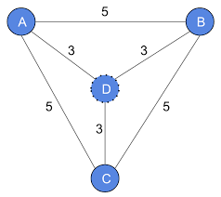
Steiner Tree and Complete Graph
Steiner Tree
Complete Graph

Slide 10
Block 1: Theorem 3.2 Proof : Part 1: Metric Closure
  Points:
  Take any graph G.
  Construct G' (Metric Closure): A complete graph where the cost of (u,v) is the shortest path distance in G.
  Visual: A graph with a winding path between A and B. In G', replace that winding path with a single direct edge of the same cost.

Slide 11
Block 1: Proof 3.2 : Part 2: Comparing Costs
  Logic: cost(u,v) in G' is ≤ cost(u,v) in G.
  Therefore, the perfect answer in the "Shortcut Map" (G') is at least as cheap as the perfect answer in the "Real Map" (G).
  OPT(G') ≤ OPT(G).
  Visual: A "Price Match" symbol. The metric map always matches or beats the original price.

Slide 12
Block 1: Proof 3.2 : Part 3: Mapping
  Logic:
  Take a Steiner Tree T' from the metric map.
  Replace each "Shortcut" with the "Real Path" from the original map.
  If you get loops (cycles), delete extra edges.
  Cost only goes down or stays same!
  Visual: A straight line A-B being replaced by its original zigzag path. Then show a circle being "cut" into a tree.

Slide 13
Block 2: MST-based Algorithm
  Concept:
    Let R be the set of Required vertices.
    An MST on R is a feasible solution (it connects everything we need).
  The Comparison:
    Finding an MST is in P (Fast).
    Finding a Metric Steiner Tree is NP-hard (Slow).
    We use the MST as a fast substitute, even if it's slightly more expensive.
  Theorem 3.3: The cost of an MST on R is within 2 · OPT.
Visual: A graph showing required nodes connected via a simple MST compared to a more complex Steiner tree using extra points.

Slide 14
Block 2: Proof of Theorem 3.3 (Part 1)
Doubling and Touring
  Step 1: Double the Edges
    Take an optimal Steiner tree (Cost = OPT).
    Double every edge (Cost = 2 . OPT).
    This creates an Eulerian graph (every node has even degree).
  Step 2: Find an Euler Tour
    Use DFS to find a tour that visits every vertex and uses every edge exactly once.
    Tour Cost = 2 . OPT.
Visual: A tree diagram where each branch is replaced by two parallel lines, and a dotted arrow showing a full "loop" around the tree.

Slide 15
Block 2: Proof of Theorem 3.3 (Part 2)
Short-cutting
  Step 3: Short-cut to Hamiltonian Cycle
    Traverse the Euler tour.
    If a Steiner vertex or a previously visited vertex appears, skip it and go to the next unvisited required vertex.
  The Logic (Triangle Inequality):
    Because the graph is metric, skipping points (short-cutting) never increases the cost.
    We now have a Hamiltonian Cycle on R with cost ≤ 2 . OPT.
  Final Step:
    Delete one edge from this cycle.
    We get a path on R with cost ≤ 2 . OPT.
Visual: Short Cut to Hamiltonian Cycle

Slide 16
Block 2: Example
  The Scenario:
    n required vertices on a circle.
    1 Steiner vertex in the dead center.
    Distance from center to any required vertex = 1.
    Distance between any two required vertices = 2.
  The Math:
    Optimal (OPT): Connect all n nodes to the center Steiner node. Cost = n.
    MST on R: Since we can't use the center, we connect nodes along the perimeter. Cost = 2(n-1).
  The Ratio:
    As n gets larger, the ratio 2(n-1)/ n approaches 2.
Visual: A "Star Graph" with n points. Show the center node being used by the Steiner tree but avoided by the MST.

Slide 17
The Traveling Salesman Problem

Slide 18
What is TSP?
  What is TSP?
    Imagine a delivery driver who needs to visit every city and return home.
  The Goal:
    Find the absolute shortest path that visits every city exactly once and returns to the start.
  Why it's hard:
    The number of possible paths grows incredibly fast (Factorial!).
  Visual: A map with cities and a single loop connecting them all efficiently.
Visual: A map with cities and a single loop connecting them all efficiently.

Slide 19
Problem 3.5 - The Traveling Salesman Problem
  Definition:
    Given a complete graph with non-negative edge costs.
    Find a minimum cost cycle visiting every vertex exactly once.
  The Hard Truth:
    In its full generality, TSP cannot be approximated at all (assuming P /= NP).
Visual: A graph with 5 vertices. Show one possible tour (1 \to 2 \to 3 \to 4 \to 5 \to 1).

Slide 20
Theorem 3.6 - Hardness of General TSP
  Statement:
    For any polynomial time computable function α(n), TSP cannot be approximated within a factor of α(n), unless P = NP.
  Simple Explanation:
    Even if you ask for an answer within a factor of 100 or 1,000,000, it's still impossible to guarantee.
Visual: A "Road Closed" sign on the way to approximating General TSP.

Slide 21
Proof of Theorem 3.6 (Part 1) - The Reduction
  The Goal: Show that approximating TSP is as hard as the Hamiltonian Cycle problem.
  The Setup:
    Transform graph G into a complete graph G'.
  Assigning Weights:
    If edge exists in G is to Cost is 1.
    If edge NOT in G is to Cost is α(n) . n (Huge!).
Visual: Graph being turned into a complete graph where "Missing" edges are thick, expensive red lines.

Slide 22
Proof of Theorem 3.6 (Part 2) - The Gap
  Case 1: Hamiltonian Cycle exists
    Tour uses only "1" edges. Total Cost = n.
  Case 2: No Hamiltonian Cycle exists
    Tour must use at least one "missing" edge.
Total Cost > α (n) . n.
  Conclusion: An approximation algorithm would easily see the "Gap" and solve an NP-hard problem.
Visual: A graph showing a "Gap" between cost n and cost \alpha(n) \cdot n.

Slide 23
Algorithm 3.7 - Metric TSP (Factor 2)
  The Recipe:
    Find an MST T of the graph.
    Double every edge of the MST (makes it Eulerian).
    Find an Euler tour T.
    Short-cut the tour to visit each city once.
Visual: 1. MST \to 2. Doubled MST \to 3. Final Tour with shortcuts.

Slide 24
Theorem 3.8 - Factor 2 Guarantee
  The Statement: Algorithm 3.7 is a factor 2 approximation algorithm for metric TSP.
  The Meaning:
    Our final tour cost will never be more than twice the optimal tour cost.
    It is a simple, reliable way to get a "good enough" answer quickly.
Visual: Equation: Cost(Tour) \leq 2 \cdot OPT.

Slide 25
Proof of Theorem 3.8
  Step-by-Step Logic:
    Lower Bound: cost(MST) ≤ OPT (Removing one edge from the optimal tour gives a tree).
  Doubling: The Euler tour T uses each edge twice: cost(T) = 2 . cost(MST).
  Triangle Inequality: Short-cutting only reduces the cost: cost(Final) ≤ cost(T).
  Result: cost(Final) ≤ 2 . cost(MST) ≤ 2 . OPT.
Visual: Mathematical derivation showing Cost \leq 2 \cdot OPT.

Slide 26
Example - Tight Case for Factor 2
  Scenario:
    n vertices. Edges cost 1 or 2.
    Optimal tour uses only "1" edges. Cost = n.
    The algorithm picks a poor Euler tour order.
    Final Cost = 2n - 2.
  Conclusion: This shows that factor 2 is the best guarantee we can give for this specific MST method.
Visual: A graph for n=6 showing a star-shaped MST leading to a poor tour.

Slide 27
Improving the Factor - Why Double Everything?
  The Problem: Doubling every edge is "wasteful."
  The Insight:
    We only need to make every vertex have an even degree to find an Euler tour.
    In an MST, only some vertices have odd degrees.
    We only need to fix those specific vertices.
Visual: An MST with "Odd-degree" vertices highlighted in Red.

Slide 28
Algorithm 3.10 - Metric TSP (Factor 3/2)
  Steps (Christofides' Algorithm):
    Find an MST T.
    Find all odd-degree vertices V'.
    Find a Minimum Cost Perfect Matching M on V'.
    Combine M + T to get an Eulerian graph.
    Find Euler tour and short-cut.
Visual: MST (lines) + Matching (dotted lines) \to Full Eulerian Graph.

Slide 29
Lemma 3.11 - Bound on Matching
  The Statement: Let V' be the set of odd-degree vertices. Let M be the minimum cost perfect matching on V'. Then cost(M) ≤ OPT/2.
  Key Idea: The matching is "cheap" because it only connects half the nodes from an optimal cycle.
Visual: Equation: cost(M) (≤) 0.5 . OPT.

Slide 30
Proof of Lemma 3.11
  Logic:
    Take the optimal tour OPT.
    Short-cut it to visit only the odd vertices (V'). This is a cycle.
    This cycle is a union of two perfect matchings (alternating edges).
    By Triangle Inequality, cost(Cycle) ≤ OPT.
    The cheaper of the two matchings must be ≤ cost(Cycle)/2 ≤ OPT/2.
Visual: A cycle of 6 nodes with edges alternating colors (Red, Blue, Red, Blue...). Showing it splits into two separate matchings.

Slide 31
Theorem 3.12 - The 3/2 Factor
  The Analysis:
    Final Cost = cost(MST) + cost(Matching)
    cost(MST) ≤ OPT
    cost(Matching) ≤ 0.5 . OPT
    Total ≤ 1.5 . OPT
  Conclusion: Christofides' algorithm is a 3/2-approximation.
Visual: Bar chart comparing 1.0 (OPT) vs 1.5 (Algorithm) vs 2.0 (Standard MST).

Slide 32
Summary & Conclusion
  Key Takeaways:
    Metric version is the "core" of both Steiner and TSP.
    Steiner Tree: MST gives factor 2.
    TSP: MST gives factor 2; Matching gives factor 1.5.

Slide 33
Questions?
Feel free to ask about the algorithms or proofs.

Slide 34
Thank You
For Your Attention
Master in Digital Technology
TU Clausthal

